Slide 1
Ohm’s Law in 5 Minutes
V = IR
Voltage = Current*Resistance

Slide 2
A circuit is like a slide (sort of)
Analogy and graphics credit to Dean Baird’s “Book of Phyz”:
http://phyz.org/phyz/BOP/10-CIRCUITS/G-Circuit_Slider.pdf

Slide 3
The riders are like units of Charge (Q) The height is like Voltage (V)
V
V
Charge (Q), measured in Coulombs (C), an SI base unit, essentially the number of electrons
Voltage (V), measured in Volts (V), units J/C, the amount of work each unit charge is capable of
Analogy and graphics credit to Dean Baird’s “Book of Phyz”:
http://phyz.org/phyz/BOP/10-CIRCUITS/G-Circuit_Slider.pdf

Slide 4
Current (I) is the rate of rider flow, A “short circuit” is like a ladder with no slide
Current (I), measured in Amperes (A), units C/s, the rate of flow of charge
Analogy and graphics credit to Dean Baird’s “Book of Phyz”:
http://phyz.org/phyz/BOP/10-CIRCUITS/G-Circuit_Slider.pdf

Slide 5
And finally, Resistance (R) is like the run length
Resistance (R), measured in Ohms (Ω), units A/V, a measure of the obstruction to flow of charge of a body
Analogy and graphics credit to Dean Baird’s “Book of Phyz”:
http://phyz.org/phyz/BOP/10-CIRCUITS/G-Circuit_Slider.pdf

Slide 6
A voltage V, applied to resistor R, will cause charge to flow from higher V to lower V with current I
We can calculate V, I or R,
if we have the other 2
V = IR
I = V/R
R = V/I
I
“Ground” symbol, a shorthand for 0 Volts

Slide 7
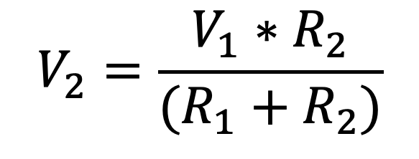
The voltage divider
From Ohm’s law, it can be shown that:
$$V_{2}=\frac{V_{1}∗R_{2}}{(R_{1}+R_{2})}$$
If R₂ = R₁,
V₂ = V₁/2
Ask about my derivation!!!

Slide 8
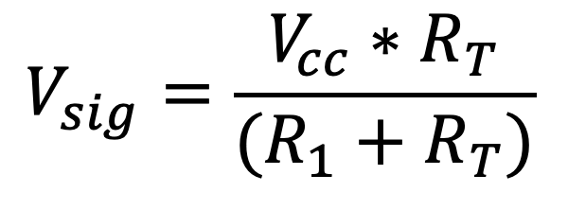
A “Thermistor” is a Resistor whose Resistance varies with Temperature
V_{cc} is shorthand for a fixed power supply voltage
V_{sig} now varies with temperature,
Creating a SIGNAL
$$V_{sig}=\frac{V_{cc}∗R_{T}}{(R_{1}+R_{T})}$$
R_{T} is now a thermistor
If we measure V_{sig}, we now have a temperature sensor!

